Slide 1
Escaping Area 51!
Game Proposal
by Tom Robinson

Slide 2
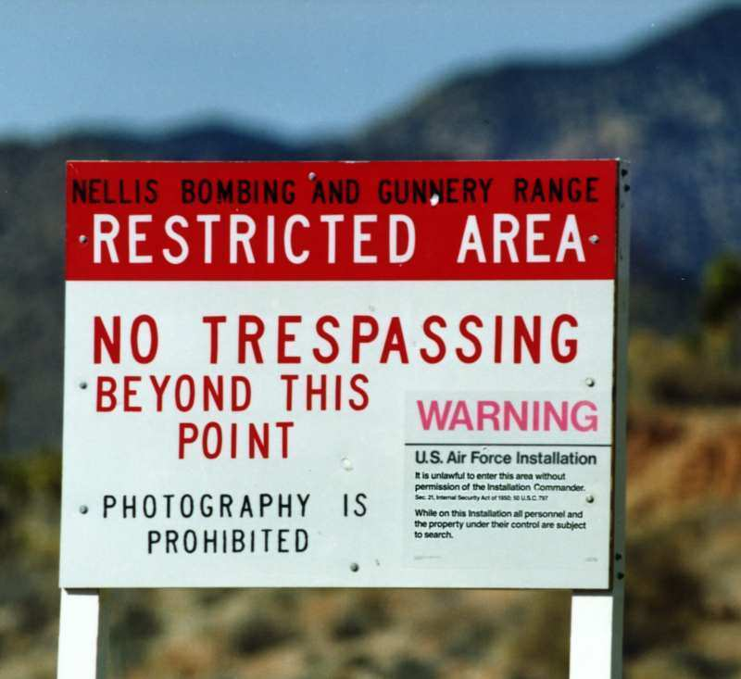
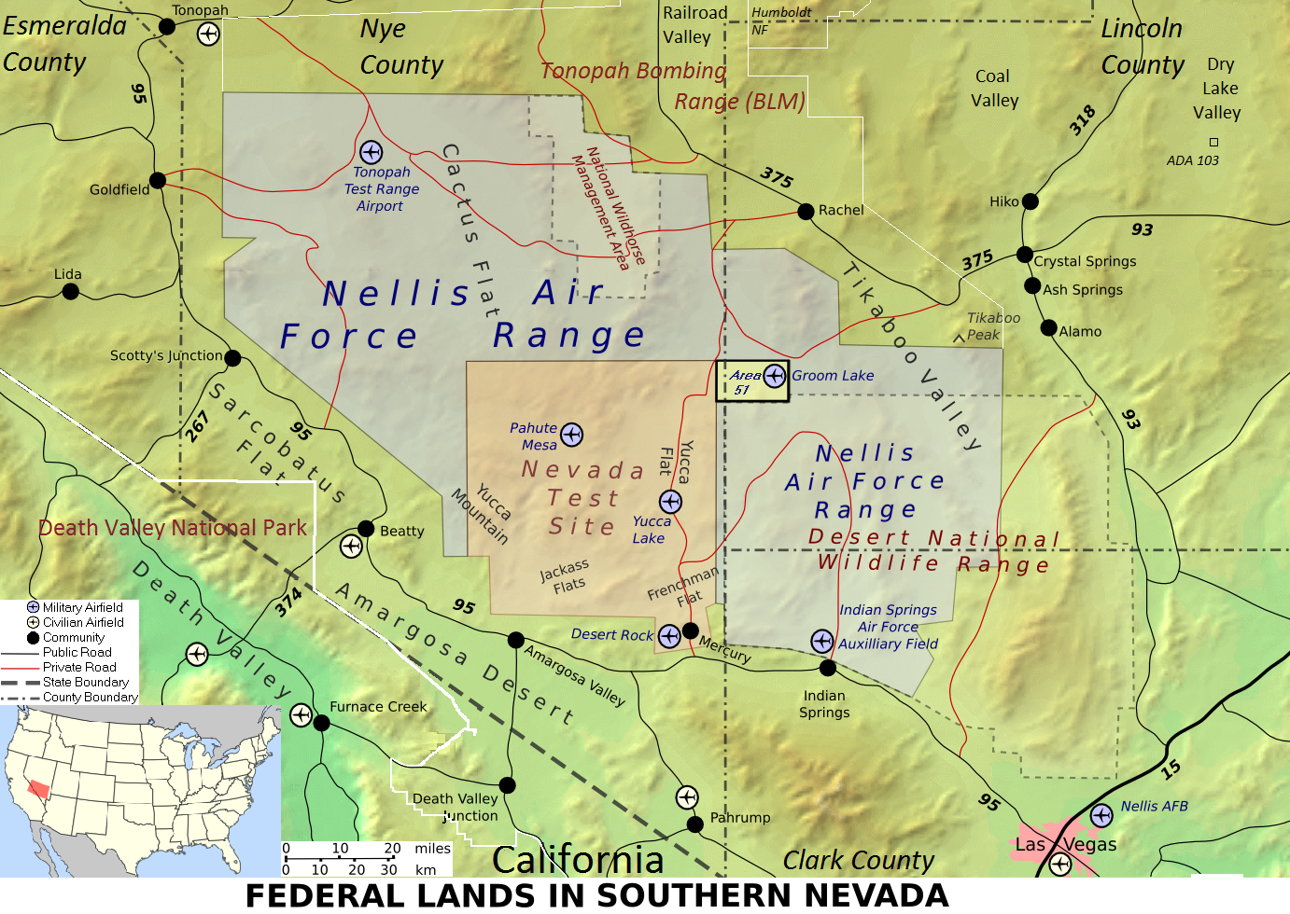
What is Area 51?
Area 51 has been dubbed by many as 'the most secretive place on earth', having been used as a base to control covert operations during the cold war, it has since become a top secret location where, for many who believe, the U.S government to hide 'extraterrestrials' and other alien objects.
The base, which is under constant severe military control, is said to be the location for Earths seemingly only visit from aliens, known as the 'Roswell Crash'. Conspiracy theorists believe the event, which occurred in 1947,involved aliens in a flying saucer crashing in Roswell, New Mexico with badly injured aliens on board. Although a government statement later stated this to be a weather balloon.

Slide 3
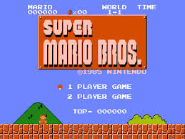
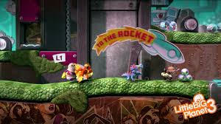
Why 2D Platformer?
2D platformers have stayed ever popular throughout the computer gaming life cycle, starting with 'Super Mario Bros' , which debatably launched the 'NES' in 1985, and going on to clearly becoming the best selling game for the industry let alone the console, and still selling millions of copies on the latest consoles of today.
With the clear success of the 'Mario bros' series it is a good starting platform to create other games based around the same theme and character(s). Or using the knowledge obtained from this series move onto a more complex 2D platformer, like PlayStation did for the 'Little Big Planet' series. (Other Platforms)

Slide 4
So.......... Onto my Game
To put the two together I will be creating a 2D platformer where you are an 'E.T' who is escaping from Area 51 (as u) . As you can imagine this is no easy task and with only your bare fists as protection you must fight your way through the oncoming military and any other conspiracists you may come across on your way to finding your mothership, which is waiting just on the mountain top ahead.

Slide 5
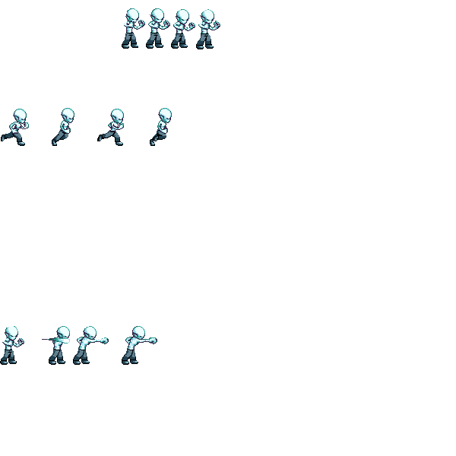
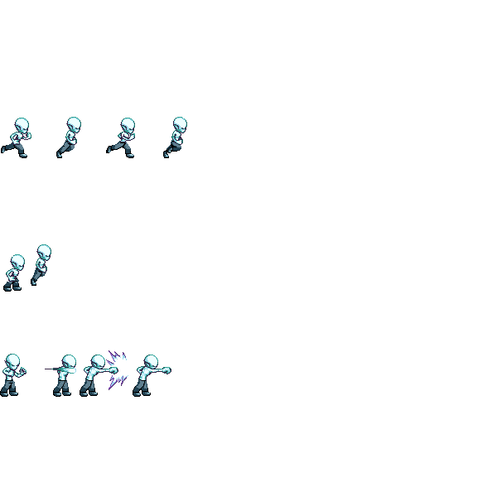
Alien Sprite Sheet (Talk about Unity Animation)
Idle
Running
Jumping
Punching

